Slide 1
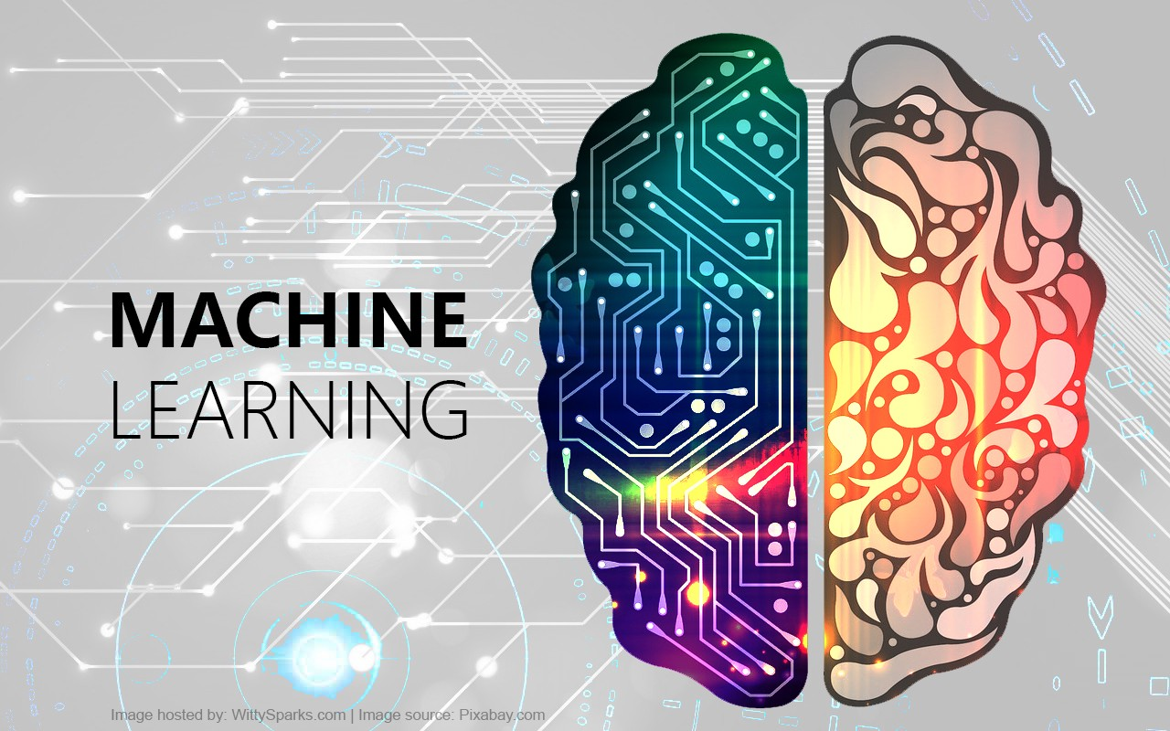
Prepared By: Prof. Vandana Kate

Slide 2
What is common?
Website giving you Recommendation
Google spam-ham filter
SIRI , CORTANA , ALEXA or a GOOGLE Assistant
Google Translator

Slide 3
Yes it is machine learning

Slide 4
What is Machine Learning?
Machine Learning is merely based on predictions made on the basis of experience.
Machines make data driven decisions , which is more efficient than explicit programming to carry out certain tasks

Slide 5
What is Machine Learning?
Machine learning (ML) is a category of an algorithm that allows software applications to become more accurate in predicting outcomes without being explicitly programmed
Machine learning is a way of identifying patterns in data and using them to automatically make predictions or decisions.

Slide 6
What is Machine Learning ?
the most popular definition by Tom Mitchell will provide more insights.
A computer program is said to learn from experience E with respect to some class of tasks T and performance measure P if its performance at tasks in T, as measured by P, improves with experience E.

Slide 7
Humans are very good in some task

Slide 8
ML techniques automatically finds valuable underlying pattern within complex data that we would otherwise struggle to find it. Eg.
credit card fraudulent transaction
Lie detector
Handwritten Digit Recognition
Web Document Classifier
Defect Detection System
Texture Classification
DNA Sequence identification
Optical Character Recognition
Those hidden pattern and knowledge can be used to predict future events and perform all kinds of complex decision making

Slide 9
Reason for Rise of Machine Learning?
the high amount of data production by
applications
the increase of computation power in the past
few years
the development of better algorithms

Slide 10
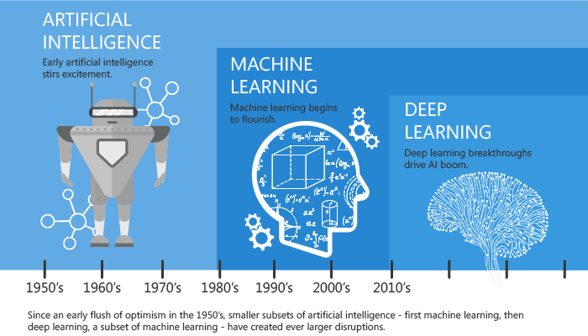
A Quick History of Machine Learning

Slide 11
Expert System
MYCIN: It was based on backward chaining and could identify various bacteria that could cause acute infections. ...
DENDRAL: Expert system used for chemical analysis to predict molecular structure.
PXDES: Expert system used to predict the degree and type of lung cancer

Slide 12
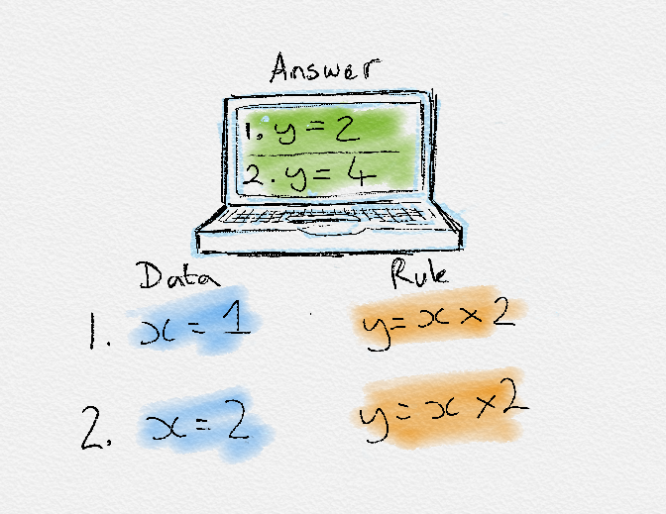
RULE BASED LEARNING

Slide 13
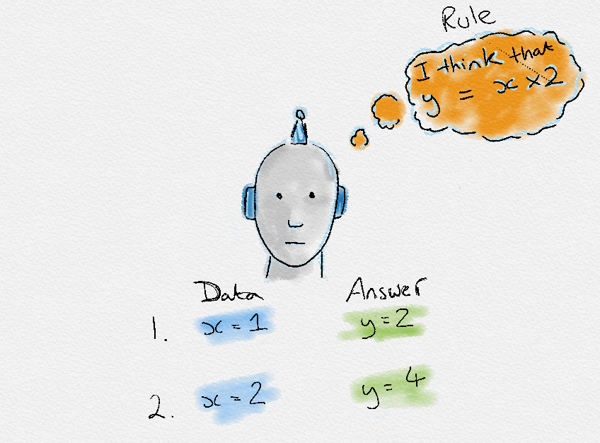
HOW MACHINE LEARNS

Slide 14
Examples of ML in use.
Prediction
Image recognition
Speech Recognition
Medical diagnoses
Financial industry

Slide 15
Types of Machine Learning?
Machine learning can be classified into 3 types of algorithms.
Supervised Learning
Unsupervised Learning
Reinforcement Learning

Slide 16

Supervised learning
the goal is to learn the mapping (the rules) between a set of inputs and outputs.

Slide 17
Types of Supervised learning
Classification: A classification problem is when the output variable is a category, such as “red” or “blue” or “disease” and “no disease”
Regression: A regression problem is when the output variable is a real value, such as “dollars” or “weight”.

Slide 18
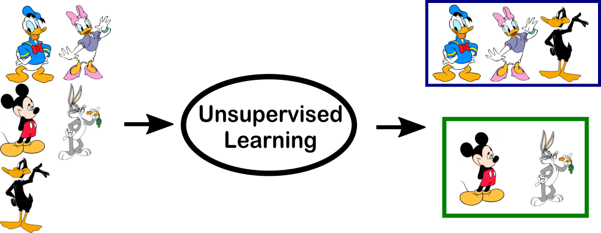
Unsupervised Learning Algorithm

Slide 19
Types of Unsupervised learning
Clustering: A clustering problem is where you want to discover the inherent groupings in the data, such as grouping customers by purchasing behavior
Association: An association rule learning problem is where you want to discover rules that describe large portions of your data, such as people that buy X also tend to buy Y

Slide 20
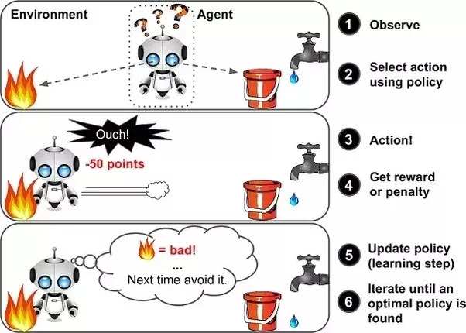
Reinforcement Learning
In this approach, occasional positive and negative feedback is used to reinforce behaviors

Slide 21
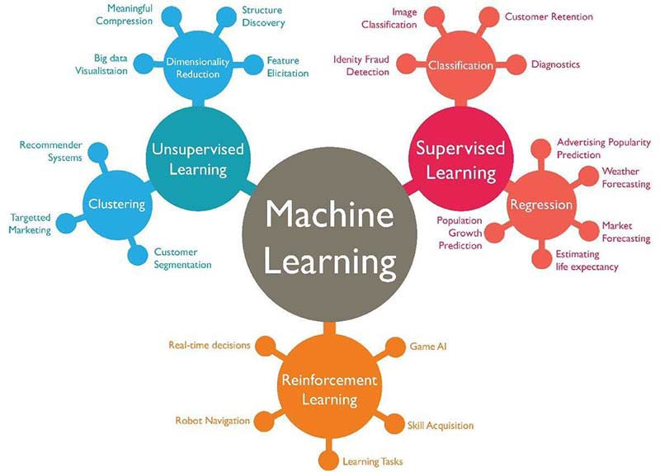

Slide 22
ML APPLICATIONS
Enhanced Unsupervised Algorithm
Highly Personalization
Collaborative Learning/Edge Analytics
Quantum Computing
Cognitive services

Slide 23
END OF LECTURE 1

Slide 24
What you'll learn
Fundamental concepts of machine learning
Linear regression, correlation, and the phenomenon of regression to the mean
Classification using the k-nearest neighbors algorithm
How to compare and evaluate the accuracy of machine learning models
Basic probability and Bayes’ theorem

Slide 25
Python the Best-Suited Programming Language for Machine Learning?
Python is Easy To Use: is simple with an easily readable syntax and that makes it well-loved by both seasoned developers and experimental students
Python has multiple Libraries and Frameworks:
Keras is an open-source library that is particularly focused on experimentation with deep neural networks.
TensorFlow is a free software library that is used for many machine learning applications like neural networks. (They seem to be quite popular!)
Scikit-learn is a free software library for Machine Learning that various classification, regression and clustering algorithms related to this. Also, Scikit-learn can be used in conjugation with NumPy and SciPy.

Slide 26
Python the Best-Suited Programming Language for Machine Learning?
Python has Community and Corporate Support
Python is Portable and Extensible

Slide 27
QUERIES?

